Slide 1


PREDICTING HOTEL BOOKING CANCELLATIONS
HENRY BIEN
DATA SCIENTIST

Slide 2




BIO
DATA SCIENTIST AT IOD
HOTEL REVENUE ANALYST
BACHELOR DEGREE OF BUSINESS ADMINISTRATION
ADVANCED DIPLOMA IN HOSPITALITY MANAGEMENT

Slide 3
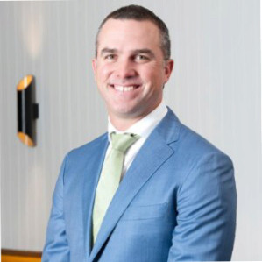

STAKEHOLDER
Kent Warren
Vice President Revenue and Analytics -
Pacific at Accor

Slide 4
AGENDA
Business problem definition
Data process design
Insights from data
Modelling & Evaluating
Conclusions & Next steps

Slide 5

BUSINESS PROBLEM DEFINITION

Slide 6
BUSINESS PROBLEM DEFINITION
IMPACT OF BOOKING CANCELLATIONS ON HOTEL REVENUE?
Limit the production of accurate forecasts on room demand and revenue.
Hotels implement rigid cancellation policies and overbooking strategies
Negative influence on revenue and reputation.

Slide 7

BUSINESS PROBLEM DEFINITION
BUSINESS QUESTION
How can we increase hotel revenue by predicting booking cancellation?
DATA QUESTION
Based on previous bookings, which machine learning model could be used to predict hotel booking cancellations?

Slide 8
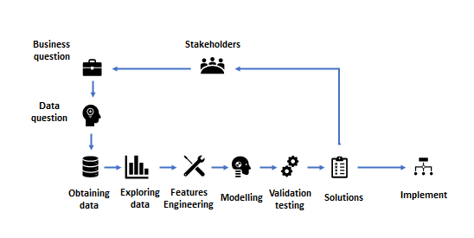
DATA PROCESS DESIGN

Slide 9
SUMMARY
Data | Approach | Results
The data was collected from the same PMS databases of 4 hotels in Europe. All four hotels are 4 stars and 5 stars ranging in sizes from 86 to 180 rooms Top 3 important features in predicting booking cancellations: _Deposit types _Lead time (Total days between booking day and arrival day) _Average Daily Rate | There is a high percentage of booking cancellations at 37, 6% over 3 years Travel Agents are the main sources of bookings Bookings made over one year in advance often lead to cancellations. Bookings with no deposit are frequently cancelled. | The model is able to predict booking cancellations RandomForestClassifier model has the best performance with 89% Accuracy. Results can allow hotel manager to reduce revenue loss from cancellations and the risks associated from overbooking.

Slide 10

INSIGHTS FROM DATA

Slide 11
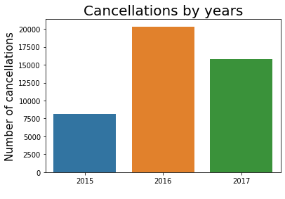
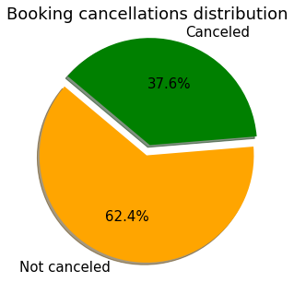
INSIGHTS FROM DATA
2016 had the highest booking cancellations in the dataset.
Over three years, these hotel had quite high booking cancellation rate at 37.6%

Slide 12
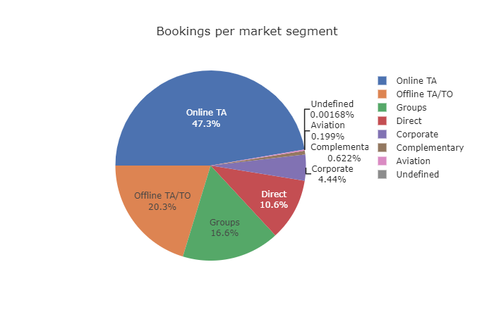
INSIGHTS FROM DATA
Travel Agents are the main market segment for room bookings.

Slide 13
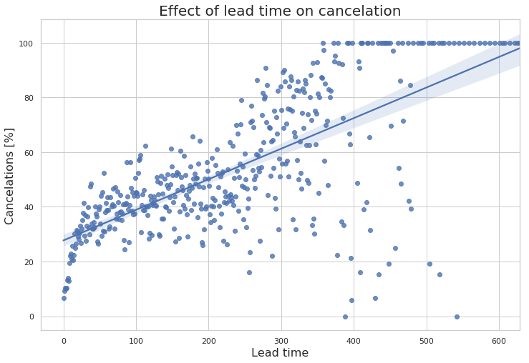
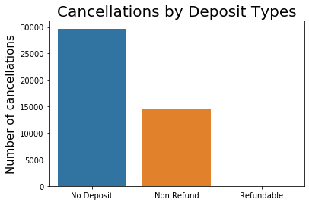
INSIGHTS FROM DATA
No deposit has the highest cancellation rate due to flexible cancellation policy
Bookings made a few days before the arrival date are rarely cancelled, whereas bookings made over one year in advance are cancelled very often.

Slide 14

MODELLING & EVALUATING

Slide 15
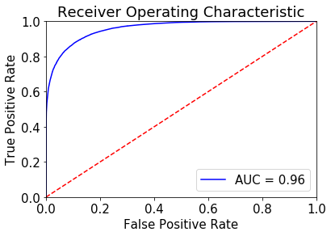
MODELLING & EVALUATING
MODEL | ACCURACY
LOGISTIC REGRESSION | 77%
XGBOOST | 84%
DECISION TREE | 86%
RANDOM FOREST | 89%
RandomForestClassifier model has the highest accuracy at 89%

Slide 16
CONCLUSIONS
RESULT
The model can be used to predict hotel booking cancellations
CANCELLATIONS PREDICTION
IMPROVE CANCELLATION POLICY
REDUCE RISKS OF CANCELLATION
BETTER OVERBOOKING TACTICS
GENERATE MORE SALES
REDUCE LOSS FROM CANCELLATIONS
INCREASE REVENUE
REDUCE RISKS

Slide 17
CONCLUSIONS
LIMITATIONS
Results may change for different hotel types, special events and natural disasters.
Overbookings from wrong booking cancellations handling could lead to bad reputation and loss of customers.

Slide 18
NEXT STEPS
Further research could make use of features from additional data sources to improve model performance and measure the influence of these features in booking cancellations. Such as:
Weather information
Prices and social reputation
Currency exchange rates
Deployment of this predictive model in a production environment

Slide 19

THANK YOU!
References:
[1] Nuno Antonio, Ana de Almeida and Luis Nunes, Predicting hotel booking cancellations to decrease uncertainty and increase revenue (2017)
[2] Nuno Antonio, Ana de Almeida and Luis Nunes, Hotel booking demand datasets (2019)
[3] Zhu, W., Zeng, N., Wang, N., & others. (2010). Sensitivity, specificity,
accuracy, associated confidence interval and ROC analysis with
practical SAS implementations. NESUG Proceedings: Health Care
and Life Sciences, Baltimore, Maryland, 1–9.

